Slide 1
Oracle PL/SQL

Slide 2
PL/SQL
Originally modeled after ADA
  Created for Dept. of Defense
Allows expanded functionality of database applications
Continues to improve with each new database release

Slide 3
PL/SQL
Features
  Tight integration with SQL
    Supports data types, functions, pseudo-columns, etc.
  Increased performance
    A block of statements sent as a single statement
  Increased productivity
    Same techniques can be used with most Oracle products
  Portability
    Works on any Oracle platform
  Tighter security
    Users may not access database objects without granted privileges

Slide 4
PL/SQL Programs
Declaration section (optional)
  Any needed variables declared here
Executable or begin section
  Program code such as statements to retrieve or manipulate data in a table
Exception section (optional)
  Error traps can catch situations which might ordinarily crash the program

Slide 5
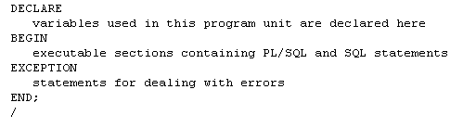
PL/SQL Block Structure

Slide 6
PL/SQL Variables
Variables are local to the code block
Names can be up to 30 characters long and must begin with a character
Declaration is like that in a table
  Name then data type the semi-colon
  Can be initialized using := operator in the declaration
  Can be changed with := in the begin section
  Can use constraints
Variables can be composite or collection types
  Multiple values of different or same type

Slide 7
Common PL/SQL Data Types
  CHAR ( max_length )
  VARCHAR2 ( max_length )
  NUMBER ( precision, scale )
  BINARY_INTEGER – more efficient than number
  RAW ( max_length )
  DATE
  BOOLEAN (true, false, null)
  Also LONG, LONG RAW and LOB types but the capacity is usually less in PL/SQL than SQL

Slide 8
PL/SQL Variable Constraints
NOT NULL
  Can not be empty
CONSTANT
  Can not be changed

Slide 9
PL/SQL Variables Examples
Age number;
Last char ( 10 );
DVal Date := Sysdate;
SID number not null;
Adjust constant number := 1;
CanLoop boolean := true

Slide 10
Block Types
Anonymous Procedure Function
[DECLARE]
BEGIN
--statements
[EXCEPTION]
END;
PROCEDURE name
IS
BEGIN
--statements
[EXCEPTION]
END;
FUNCTION name
RETURN datatype
IS
BEGIN
--statements
RETURN value;
[EXCEPTION]
END;
Notes:
Block Types
A PL/SQL program comprises one or more blocks. These blocks can be entirely separate or nested within another block. There are three types of blocks that make up a PL/SQL program. They are:
Anonymous blocks
Procedures
Functions
Anonymous blocks: Anonymous blocks are unnamed blocks. They are declared inline at the point in an application where they are to be executed and are compiled each time the application is executed. These blocks are not stored in the database. They are passed to the PL/SQL engine for execution at run time. Triggers in Oracle Developer components consist of such blocks. These anonymous blocks get executed at run time because they are inline. If you want to execute the same block again, you have to rewrite the block. You are unable to invoke or call the block that you wrote earlier because blocks are anonymous and do not exist after they are executed.

Slide 11
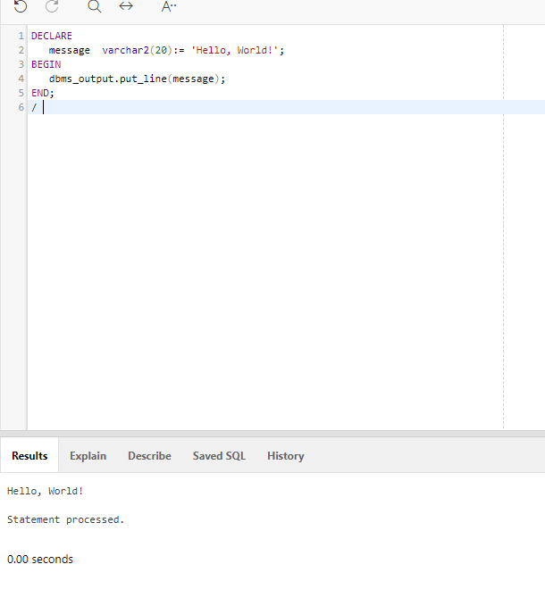
Create your first anonymous block

Slide 12
Conditional Structures
IF-THEN
IF-THEN-ELSE
IF-THEN-ELSIF
  An alternative to nested IF-THEN_ELSE

Slide 13

IF-THEN Structure

Slide 14
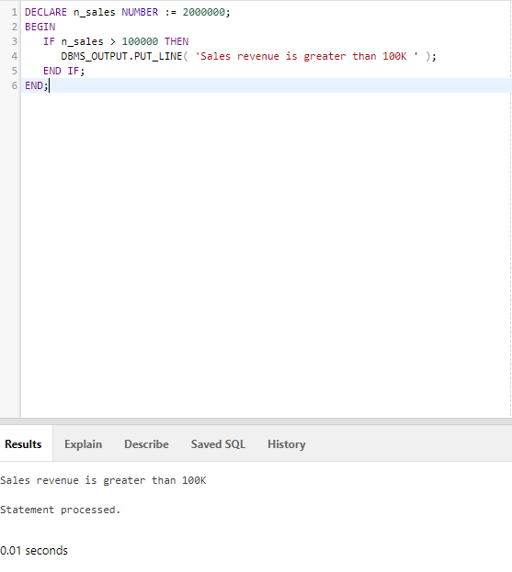
Example

Slide 15

IF-THEN-ELSE Structure

Slide 16
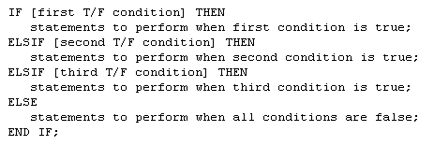
IF-THEN-ELSIF Structure

Slide 17
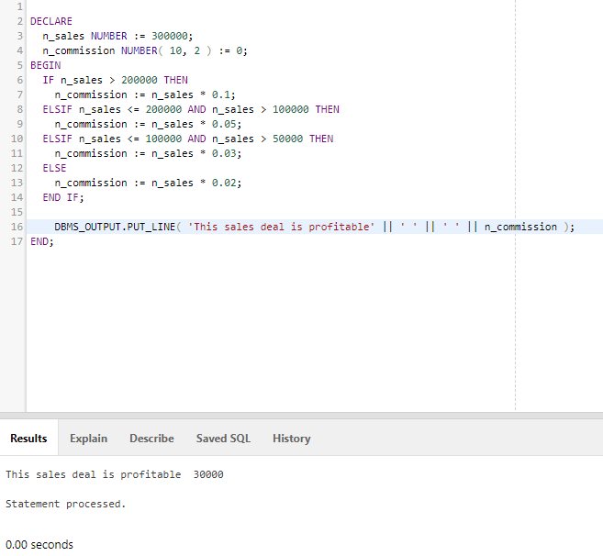
Example

Slide 18
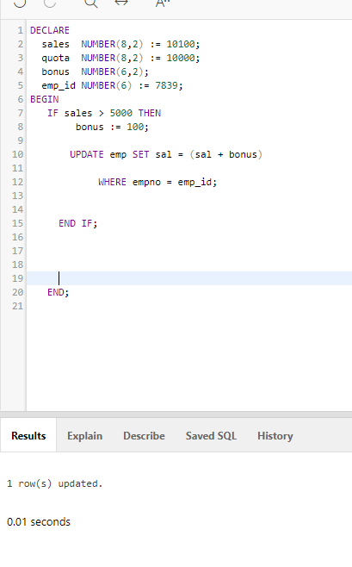
Let us try to access an existing record
Check if it is updated

Slide 19
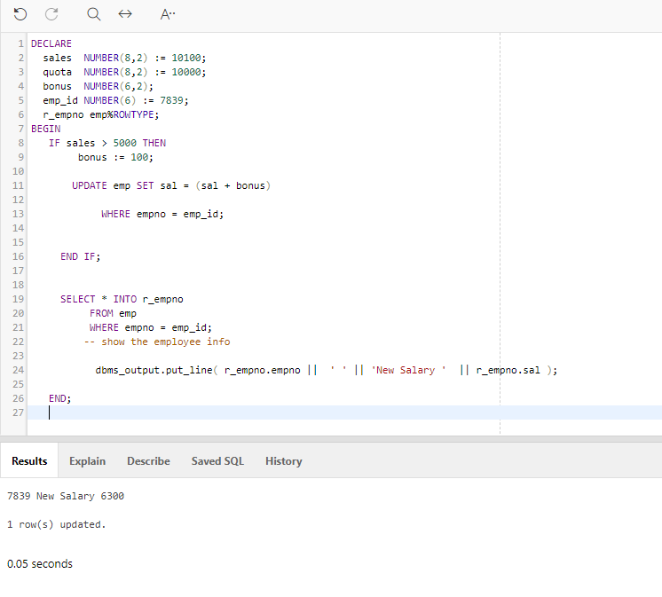
Let us try to show the results based in the block itself

Slide 20
Iterative Structures
LOOP … EXIT … END LOOP
  EXIT with an If Avoids Infinite Loop
LOOP … EXIT WHEN … END LOOP
  Do Not Need An If to Control EXIT
WHILE … LOOP … END LOOP
  Eliminates Need for EXIT
FOR … IN … END LOOP
  Eliminates Need for Initialization of Counter

Slide 21
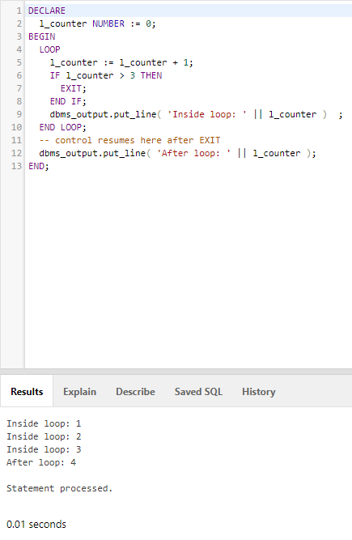
Loop Example

Slide 22
Class Exercise
Create an anonymous block that will accept the hours and the hourly wage and compute the total wage.
Create an anonymous block that will create a table, get data from another table and insert these data to the new table created.

Slide 23
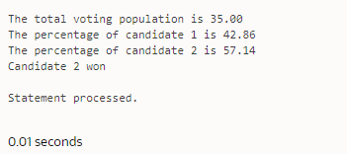
Exercise 1
Create an anonymous block that will do the following:
  Accept votes for two candidates
  Compute the total voting population
  Determine the percentage each vote got based on the total voting population
  Display the TVP and the percentages
  Determine who is the winner
  Detect if there is a tie and display it is a tie

Slide 24
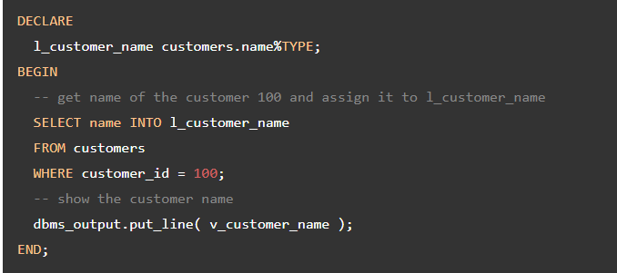
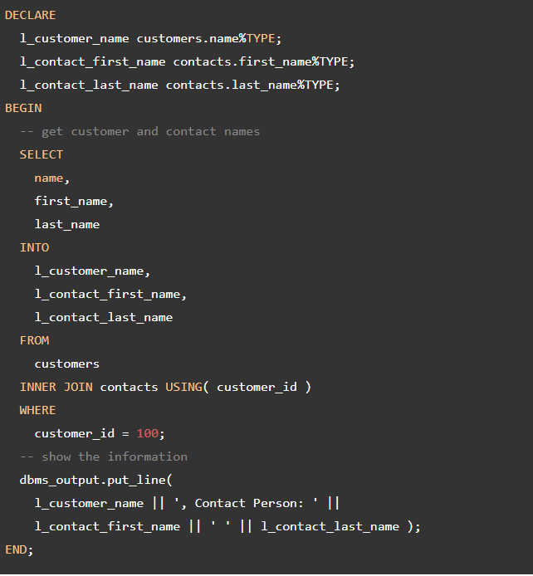
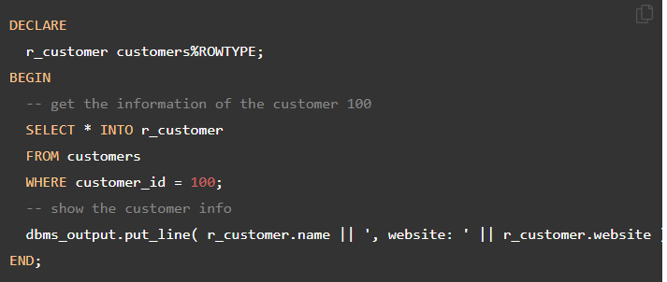
The into statement
SELECT INTO statement is the simplest and fastest way to fetch a single row from a table into variables.

Slide 25
Cursors
Result Set
MIS380 DATABASE DESIGN 4
MIS202 INFORMATION SYSTEMS 3 <Cursor
MIS485 MANAGING TECHNOLOGY 4
MIS480 ADVANCED DATABASE 4

Slide 26
Cursors
Declaring an Explicit Cursor
CURSOR CursorName IS SelectStatement;
Opening an Explicit Cursor
OPEN CursorName;
Accessing Rows from an Explicit Cursor
FETCH CursorName INTO RowVariables;

Slide 27
Cursors
Cursors Hold Result of an SQL Statement
Two Types of Cursors in PL/SQL
  Implicit – Automatically Created When a Query or Manipulation is for a Single Row
  Explicit – Must Be Declared by the User
    Creates a Unit of Storage Called a Result Set

Slide 28
Cursors
Declaring Variables of the Proper Type with %TYPE
VarName TableName.FieldName%TYPE;
Declaring Variables to Hold An Entire Row
VarName CursorName%ROWTYPE;
Releasing the Storage Area Used by an Explicit Cursor
CLOSE CursorName;

Slide 29
Cursor Control With Loops
Need a Way to Fetch Repetitively
Need a Way to Determine How Many Rows to Process With a Cursor
  Cursor Attributes
    CursorName%ROWCOUNT – Number of Rows in a Result Set
    CursorName%FOUND – True if a Fetch Returns a Row
    CursorName%NOTFOUND – True if Fetch Goes Past Last Row

Slide 30
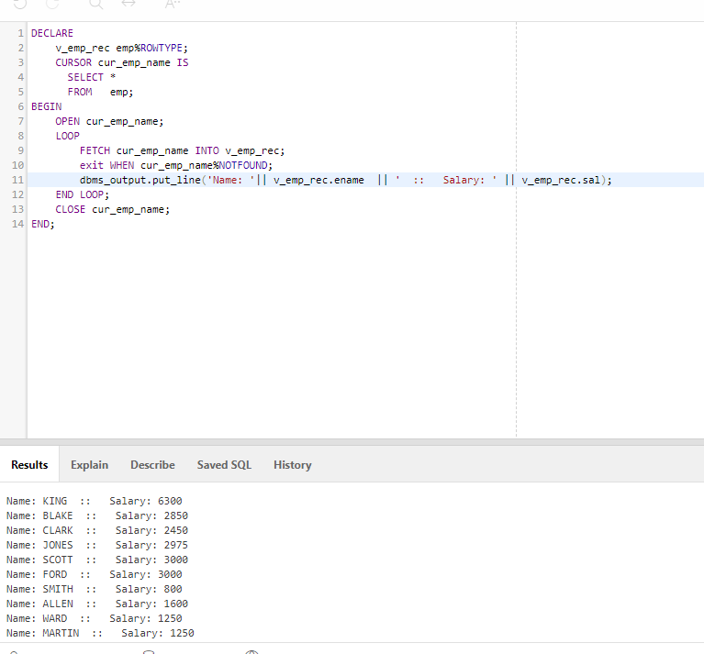
Let us try to access data using loop

